Slide 2



WORDLE
COMPRO 1

Slide 3
HOW IT WORK

Slide 4
DATA

Slide 5
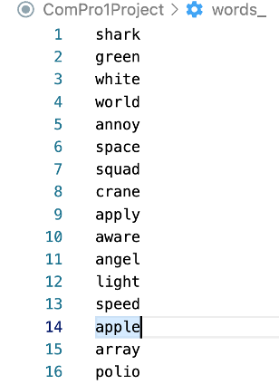
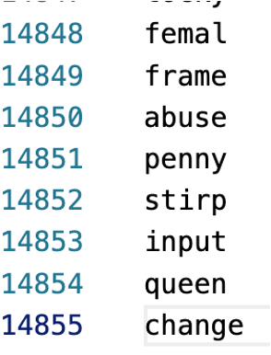
DATA

Slide 6
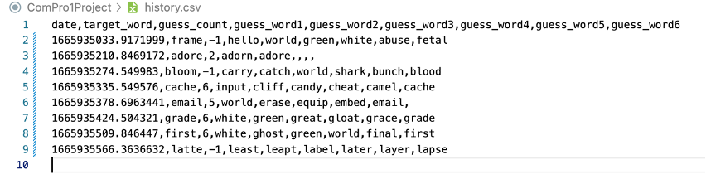
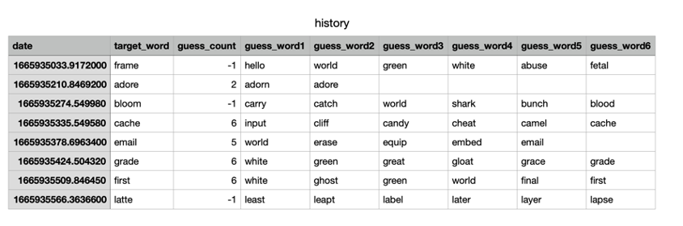
DATA

Slide 7
ENTRYLIST
BUTTONLIST
CONTAINER
TEXTVARIABLELIST
CURRWORDSTATE
TARGETWORDCOUNT
WORDLIST
GUESSLIST

Slide 8
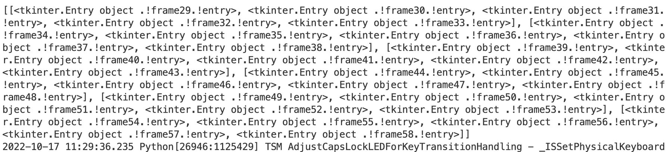
ENTRYLIST
CONTAINER

Slide 9
ENTRYLIST
BUTTONLIST
CONTAINER
TEXTVARIABLELIST
CURRWORDSTATE
TARGETWORDCOUNT
WORDLIST
GUESSLIST

Slide 10
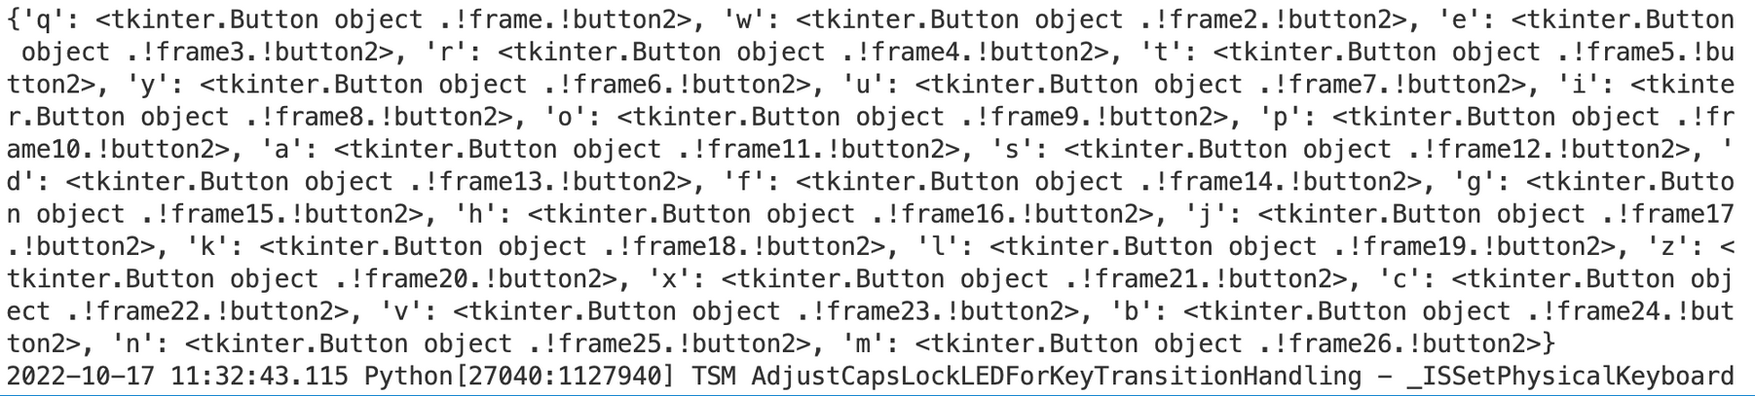
BUTTONLIST
CONTAINER

Slide 11
ENTRYLIST
BUTTONLIST
CONTAINER
TEXTVARIABLELIST
CURRWORDSTATE
TARGETWORDCOUNT
WORDLIST
GUESSLIST

Slide 12
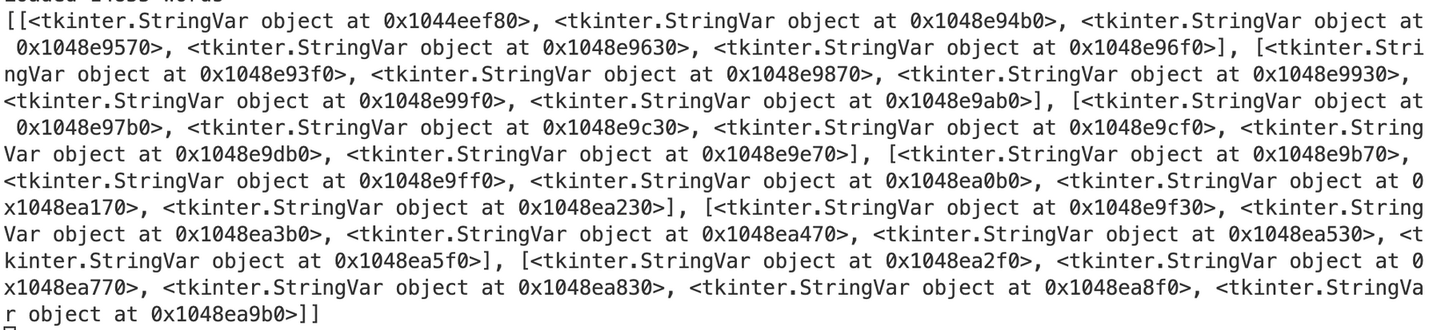
TEXTVARIABLELIST
CONTAINER

Slide 13
ENTRYLIST
BUTTONLIST
CONTAINER
TEXTVARIABLELIST
CURRWORDSTATE
TARGETWORDCOUNT
WORDLIST
GUESSLIST

Slide 14
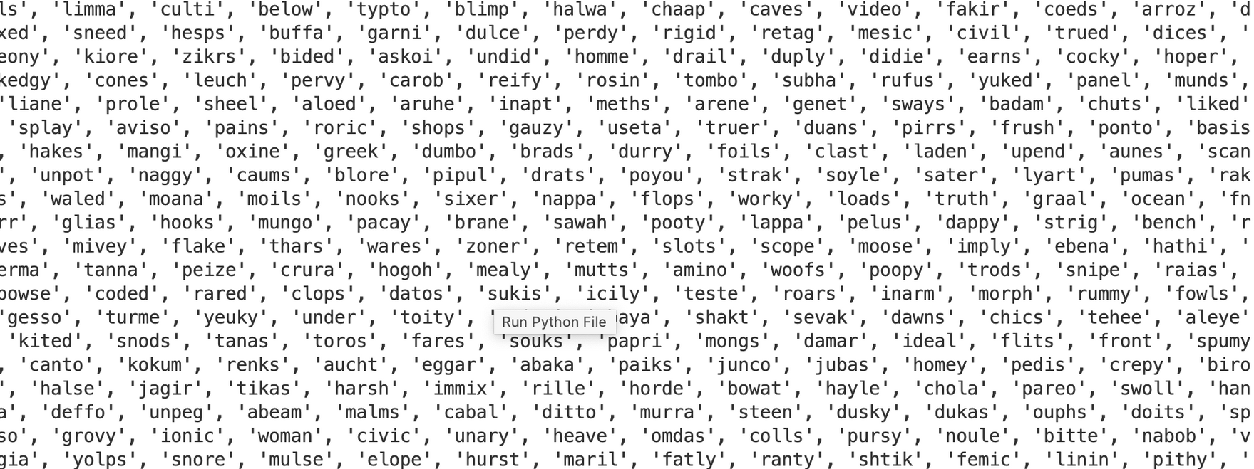
CONTAINER
WORDLIST

Slide 15
ENTRYLIST
BUTTONLIST
CONTAINER
TEXTVARIABLELIST
CURRWORDSTATE
TARGETWORDCOUNT
WORDLIST
GUESSLIST

Slide 16
CONTAINER
GUESSLIST

Slide 17
ENTRYLIST
BUTTONLIST
CONTAINER
TEXTVARIABLELIST
CURRWORDSTATE
TARGETWORDCOUNT
WORDLIST
GUESSLIST

Slide 18
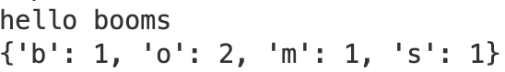
CONTAINER
TARGETWORDCOUNT

Slide 19
ENTRYLIST
BUTTONLIST
CONTAINER
TEXTVARIABLELIST
CURRWORDSTATE
TARGETWORDCOUNT
WORDLIST
GUESSLIST

Slide 20
CURRWORDSTATE
CONTAINER

Slide 21

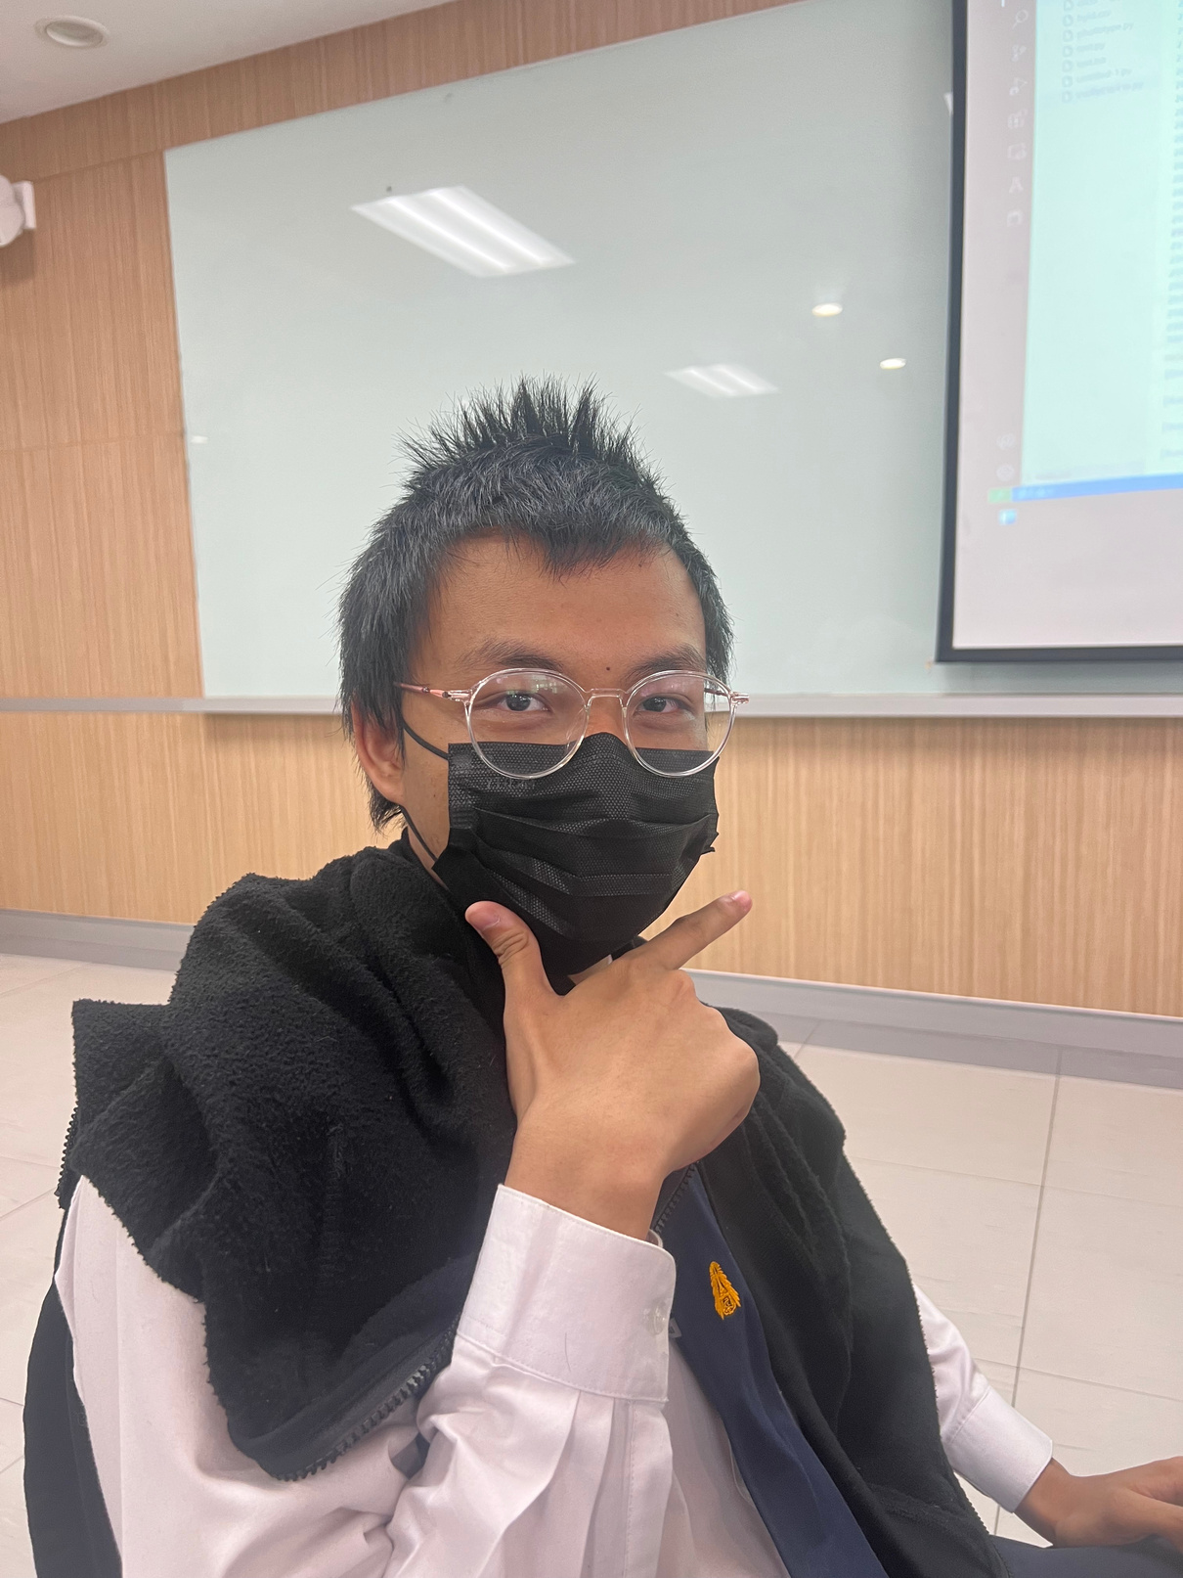

ATHICHA LEKSANSERN
TONKAEW
MOK MARRD
MOK

